Slide 1





OpenPilot
Conceptual Architecture

Slide 2

Table of contents
01
06
02
07
03
08
04
09
05
10
How the System Evolves
Introduction
Key Features
Control and Dataflow
Concurrency in OpenPilot
How it Works
High Level Architecture
Implications for Developers
Main Components
Conclusion

Slide 3



01
Introduction

Slide 4
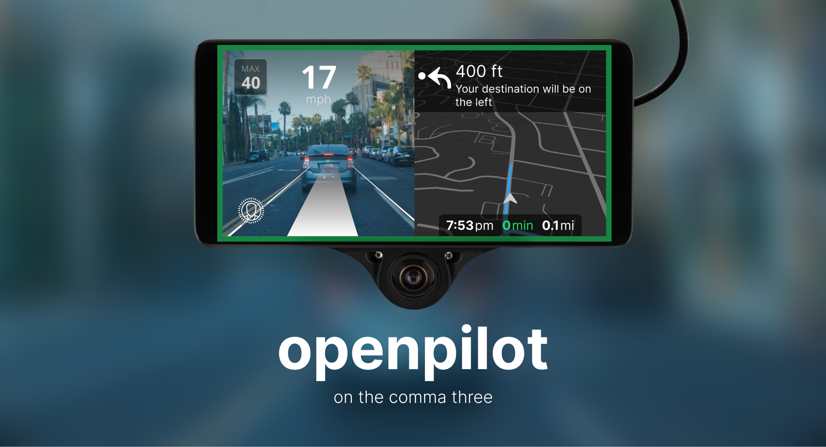
Introduction
What is OpenPilot?
An open-source driving assistant developed by Comma.AI
Enabling advanced features using machine learning to understand the road and how your car moves

Slide 5



Activate
OpenPilot Software
Monitor
Camera feed
Analyze Lane and calculate adjustments
Based on calculated data, adjust as necessary:
Speed
Vehicle Direction

Slide 6
02
Key Features

Slide 7


Key Features
Automated Steering and Speed Control
Driver watch/Monitoring
Geo Positioning and Calibration
Strategizing
Assisted lane change
Software updates

Slide 8
03
How it Works

Slide 9
How it Works
Sensors and cameras collect environment and driver data
Neural networks analyze for understanding and prediction
Planning services decide on steering, acceleration, and lane switching
Continuous action evaluation via sensors and cameras
Real-time model and decision adjustments

Slide 10
04
High Level Architecture

Slide 11
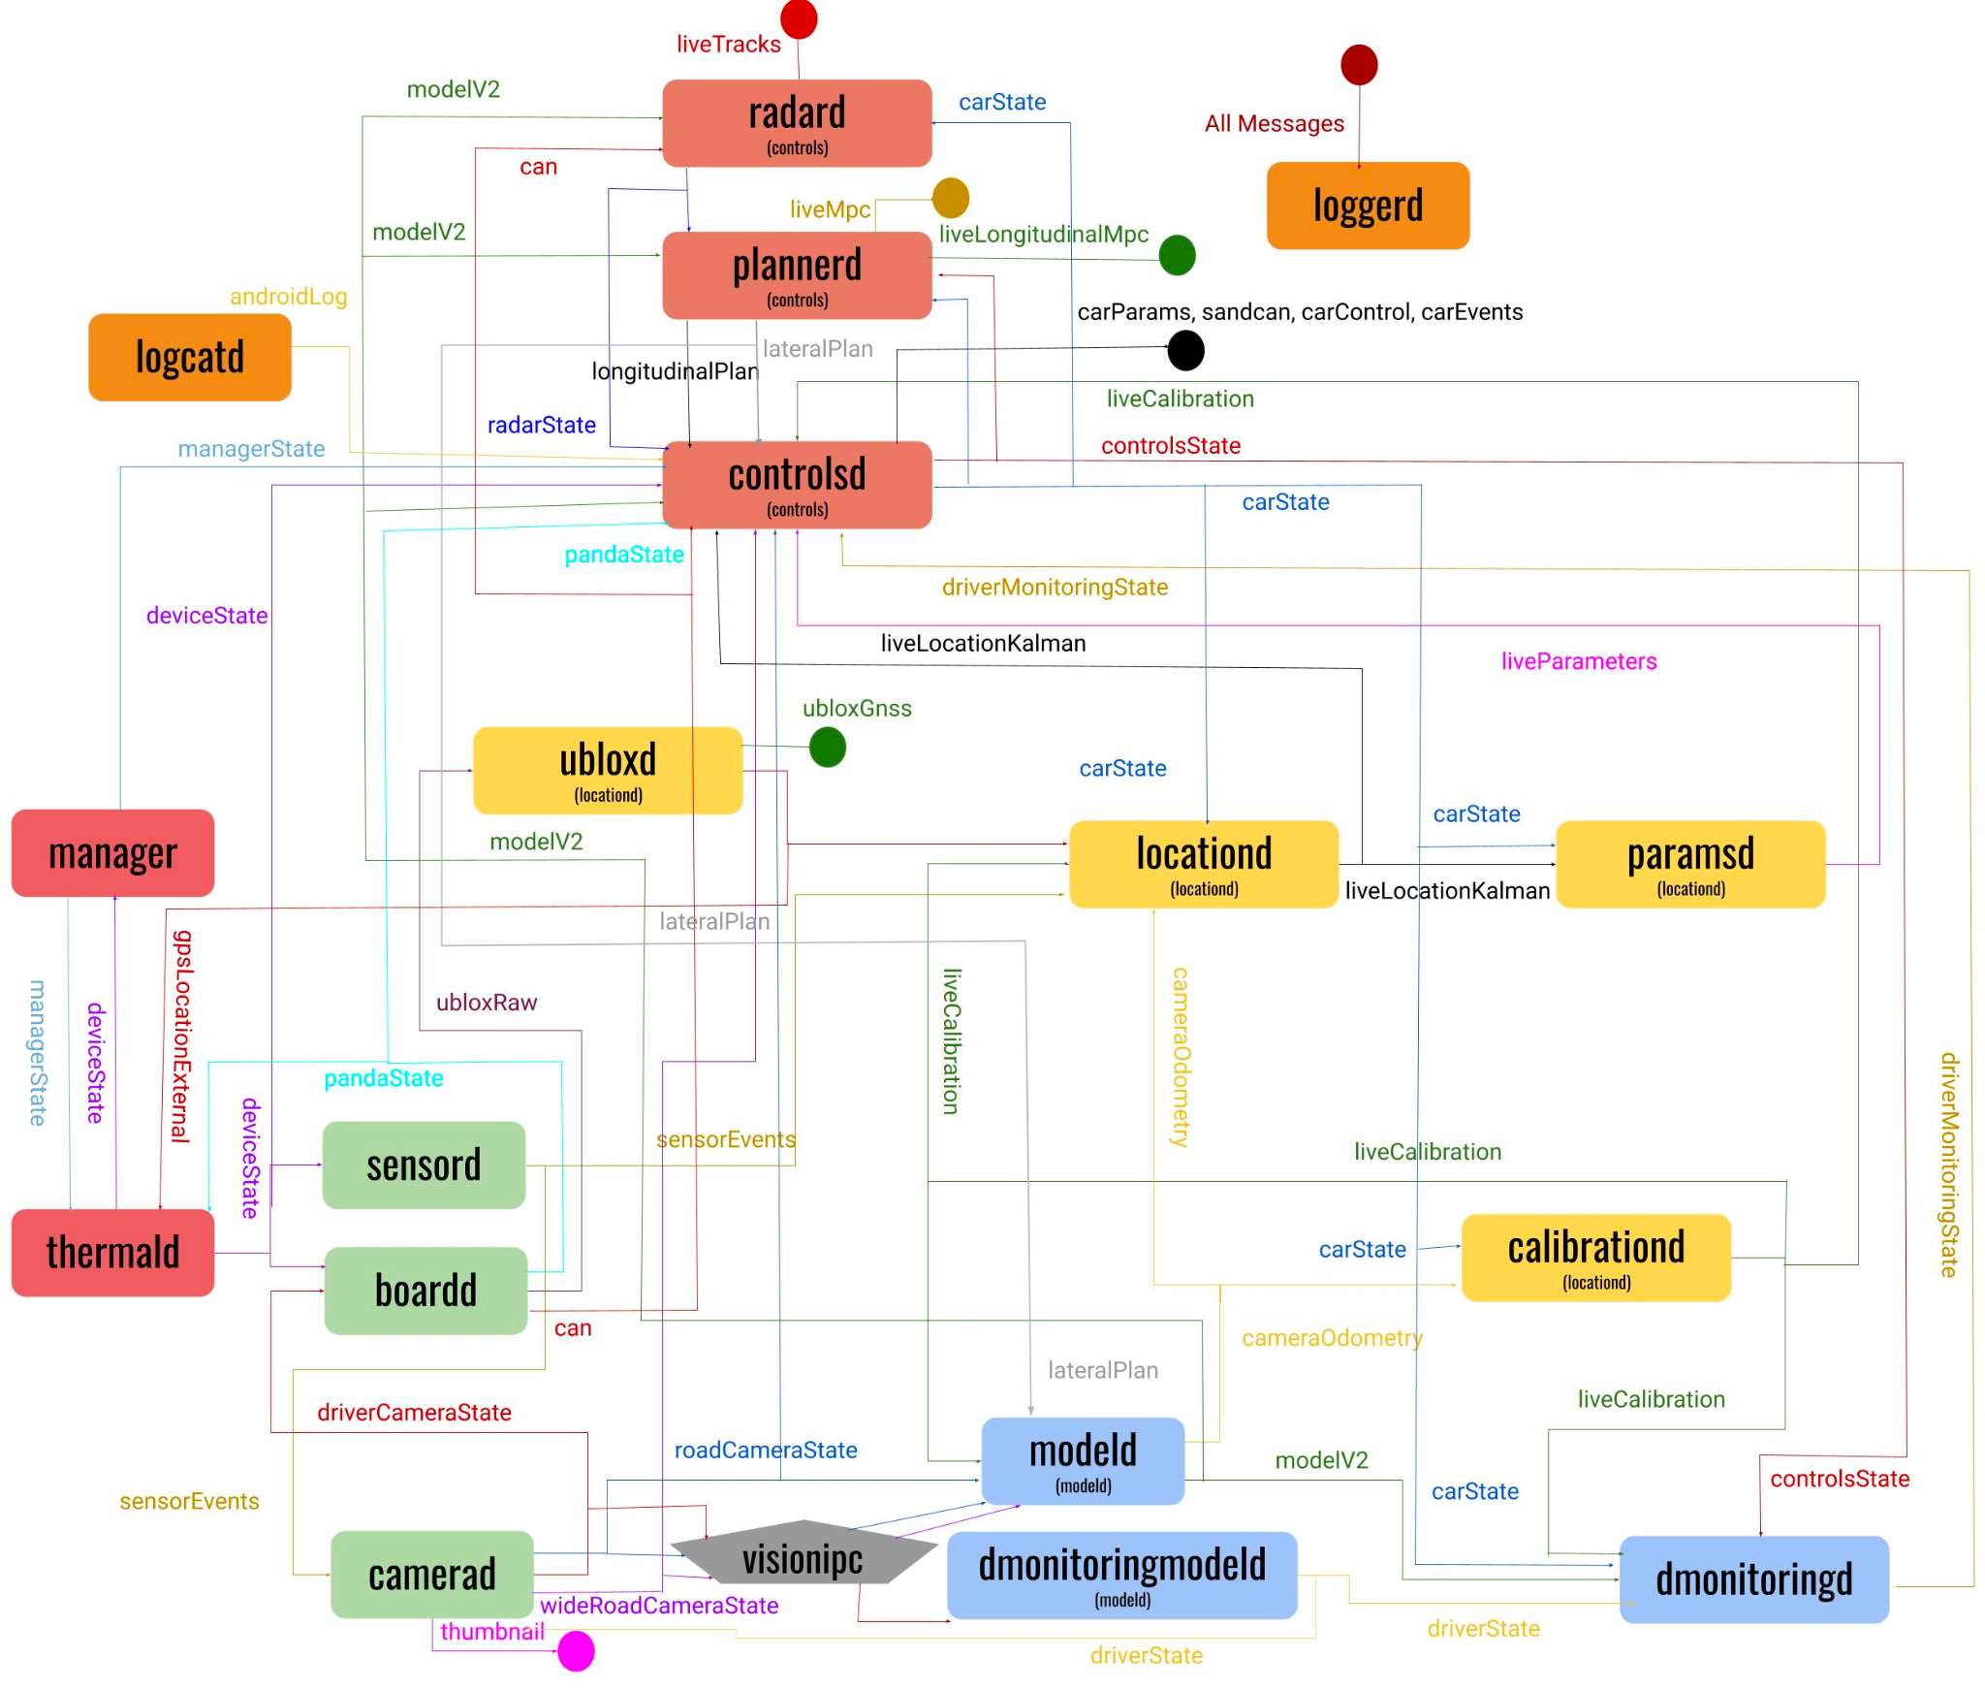

Slide 12
05
Main Components

Slide 13
Main Components
Sensors and Actuators Management Services
Neural Network Runners
Controls
Boardd
Camerad
sensord
modeld
dmonitoringmodeld
Dmonitoringd
Radard
Plannerd
controlsd
Localization and Calibration Services
Navigation
System, Logging, and Miscellaneous Services
Ubloxd
Locationd
Calibrationd
paramsd
torqued
navd
map_renderer
Manager
Thermald
loggerd/logcatd/proclogd
Athenad
ui

Slide 14
06
How Does the System Evolve

Slide 15

How Does the System Evolve
The development of OpenPilot’s driver assistance system has been largely driven by the following:
Community Contributions
Data Collection and Analysis
Machine Learning and AI
Software Updates

Slide 16
7
Control and Dataflow

Slide 17

Control And Dataflow
Interplay between hardware and software enables OpenPilot to provide an advanced level of driver assistance
Sensors and Input Data
Data Processing and Decision Making
Actuation and Control
Feedback Loop
User Interaction:
Notes:
Is the sophisticated interplay between hardware and software which enables OpenPilot to provide an advanced level of driver assistance
Sensors and Input Data:
Integrates vehicle's built-in sensors with OpenPilot's cameras and sensors to gather comprehensive environmental data.
Data Processing and Decision Making:
Employs real-time processing with machine learning models on the Comma device to interpret sensory data, recognizing lane markings, vehicles, and road signs.
Actuation and Control:
Sends control signals via the vehicle's CAN bus for steering, acceleration, and braking based on algorithmic decisions.
Feedback Loop:
Monitors vehicle responses to refine actions in real-time, enhancing system accuracy and reliability.
User Interaction:
Features a user interface on the Comma device for system status, manual overrides, and customization options.

Slide 18
8
Concurrency In OpenPilot

Slide 19
Concurrency
MSGQ for IPC
Parallel Sensor Data Processing
A lock free single producer multi consumer message queue. Uses a ring buffer in shared memory to efficiently read and write data for Inter Process Communication
Receives data from multiple sensors simultaneously, including cameras, LiDAR, radar, and GNSS receivers.
Asynchronous Control
Computational Efficiency
Analyzing sensor data and making control decisions is done concurrently,, enabling the system to react swiftly to dynamic changes in the environment.
The perception and localization modules involve computationally intensive tasks. Concurrency is utilized to distribute these tasks across multiple threads

Slide 20
9
Implications for Developers

Slide 21
Implications for Developers
Role Specialization and Collaboration
Modular Architecture and Scalability
Safety and Quality Prioritization
Contribution Guidelines and Best Practices
Notes:
Specialization of Roles and Collaboration: Developers play specific roles and It's vital to understand each role within the ecosystem for smooth integration and peak performance.
Effective coordination and communication are essential for aligning responsibilities and sharing knowledge.
Modular Architecture and Scalability: The modular architecture encourages enhancements and the addition of new features. As developers, It's important to make long-term architectural decisions that can accommodate future requirements.
Emphasis on Safety and Quality: These a important factors in Openpilots’ system. Contributions should aim at refining the system and fixing bugs rather than introducing new features or UI design changes.
Contributing to CourseWare: Contributions should steer clear of large pull requests without clear objectives, focusing instead on typo fixes, code cleanup, or porting car models

Slide 22
Implication for Developers
Specialization of Roles and Collaboration
Modular Architecture and Scalability
Specialization of Roles and Collaboration: Developers play specific roles and It's vital to understand each role within the ecosystem for smooth integration and peak performance.
The modular architecture encourages enhancements and the addition of new features. As developers, It's important to make long-term architectural decisions that can accommodate future requirements.
Emphasis on Safety
Contribution Guidelines and Best Practices
Safety is a big concern in Openpilots’ system. Contributions should aim at refining the system and fixing bugs rather than introducing new features or UI design changes.
Contributions should steer clear of large pull requests without clear objectives, focusing instead on typo fixes, code cleanup, or porting car models

Slide 23
10
Conclusion

Slide 24
Key ideas in market opportunity
Research new markets
Innovative solutions
Analyze existing customer needs and identify gaps in the market to find
new opportunities
Utilize technology and customer feedback to come up with novel solutions that meet your customer’s demands or needs
Stay ahead of trends
Seasonal spikes
Monitor changes in the marketplace, such as shifts in consumer behavior or emerging technologies, to stay competitive and capitalize on new opportunities and trends
Identify times of year when demand for certain products may spike, such as holidays or special occasions, and use these times to target customers or maximize sales

